Slide 1
Identity Management
Chapter 13

Slide 2
What is Identity Management?
A system of standards, procedures and technologies that provides electronic credentials to individuals.
Maintains authoritative information about individuals.
Establishes the trust needed for transactions.
Facilitates and controls user access to online applications or resources.

Slide 3

What is Identity Management?
Who are you? (identification)
Collect personally identifying information to prove you are who you say you are (identity proofing), such as drivers license, passport, or biometric data
Assign attributes [(name, address, college or university, department, role (faculty, staff, student), major, email address]
How can you prove it? (authentication)
Verifying that the person seeking access to a resource is the one previously identified and approved

Slide 4
Key Terms
Authentication – Verification (via a user ID and password) that a user is who they claim to be. Multi-factor authentication can be used.
Authorization – Determining whether a user is eligible to gain access to a resource or service. The authorization decision is made by the company where the user works in.
Accounting – Charges user for what they use.

Slide 5
Identity Management tools
Typically companies use
RADIUS (Remote Authentication Dial-In User Service)
TACACS+(Terminal Access Control Access Control Server Plus )
to authenticate and authorise users.
Source from Linksys

Slide 6
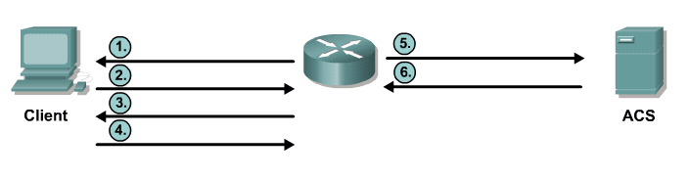
RADIUS Protocol
is an open IETF standard AAA protocol for applications such as network access or IP mobility.
hides passwords during transmission but the rest of the packet is sent in plaintext.
combines authentication and authorization as one process which means that when a user is authenticated, that user is also authorized.
  uses UDP port 1645 or 1812 for authentication and UDP port 1646 or 1813 for accounting.
Access-Request
(JR_ADMIN, “Str0ngPa55w0rd”)
Username?
JR-ADMIN
Access-Accept
Password?
Server
Str0ngPa55w0rd

Slide 7
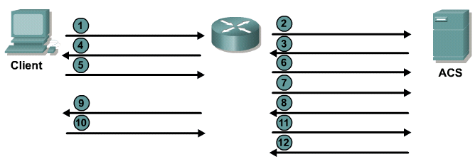
TACACS+ Protocol
Both protocols can be used to communicate between client and AAA servers.
TACACS+ is considered the more secure protocol because all exchanges are encrypted.
Radius only encrypts the user password. It does not encrypt user names, accounting information, or any other information carried in the radius message.
Connect
Username prompt?
Username?
Use “Username”
JR-ADMIN
JR-ADMIN
Server
Password prompt?
Password?
Use “Password”
“Str0ngPa55w0rd”
“Str0ngPa55w0rd”
Accept/Reject

Slide 8
TACACS+ Vs RADIUS
Feature | TACACS+ | RADIUS
Functionality | Separates AAA according to the AAA architecture, allowing modularity of the security server implementation | Combines authentication and authorization but separates accounting, allowing less flexibility in implementation than TACACS+.
Standard | Mostly Cisco supported | Open/RFC standard
Transport Protocol | TCP port 49 | UDP port 1645 or 1812 for authentication UDP port 1646 or 1813 for accounting
CHAP | Bidirectional challenge and response as used in CHAP | Unidirectional challenge and response from the RADIUS security server to the RADIUS client.
Protocol Support | Multiprotocol support | No ARA, no NetBEUI
Confidentiality | Entire packet encrypted | Only the password is encrypted
Customization | Provides authorization of router commands on a per-user or per-group basis. | Has no option to authorize router commands on a per-user or per-group basis.
Accounting | Limited | Extensive

Slide 9
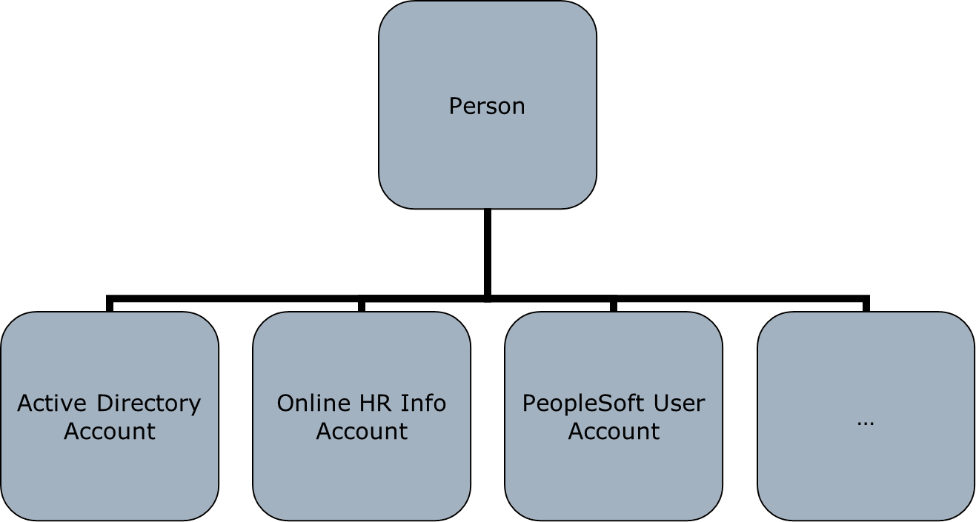
Problems with Identity Management
Networks use multiple identity systems
Users get confused with all of these IDs
Management and audit has difficulty keeping track of all these IDs
Results in Identity theft

Slide 10
Many are impacted…
End-users | Too many IDs Too many passwords Must wait for access to applications
Administrators | Too many IDs Too many end-user requests Difficult or unreliable ways to syncs all the accounts
Audit/Compliance | Orphaned accounts Limited or no audit capability Where are the audit trails?

Slide 11
Solutions for an effective IM
Single Sign On
a user logs in with a single ID and password to gain access to a connected system or systems without using different usernames or passwords, or in some configurations seamlessly sign on at each system.
Automated password reset links
User answers predefined questions to verify identity and an automated tool will reset password for user.
Automated user provisioning to Active Directory
Auto-provisioning. For example:
  Monitor an HR application and automatically create new users on other systems and applications when new employee records appear in the HR database.
Auto-deactivation. For example:
  Monitor an HR application and automatically deactivate users objects on other systems and applications when an employee records either disappears or is marked as inactive in the HR database.

Slide 12
THE END

